Slide 1


Slide 2
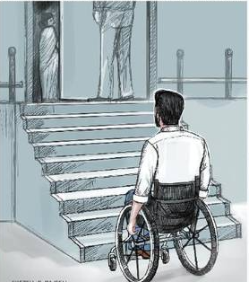

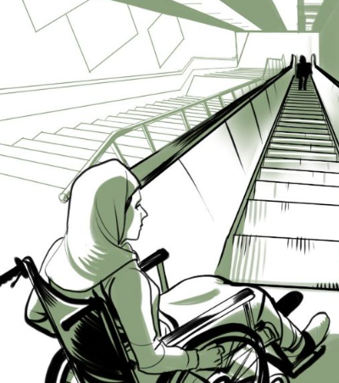
Problem

Slide 3

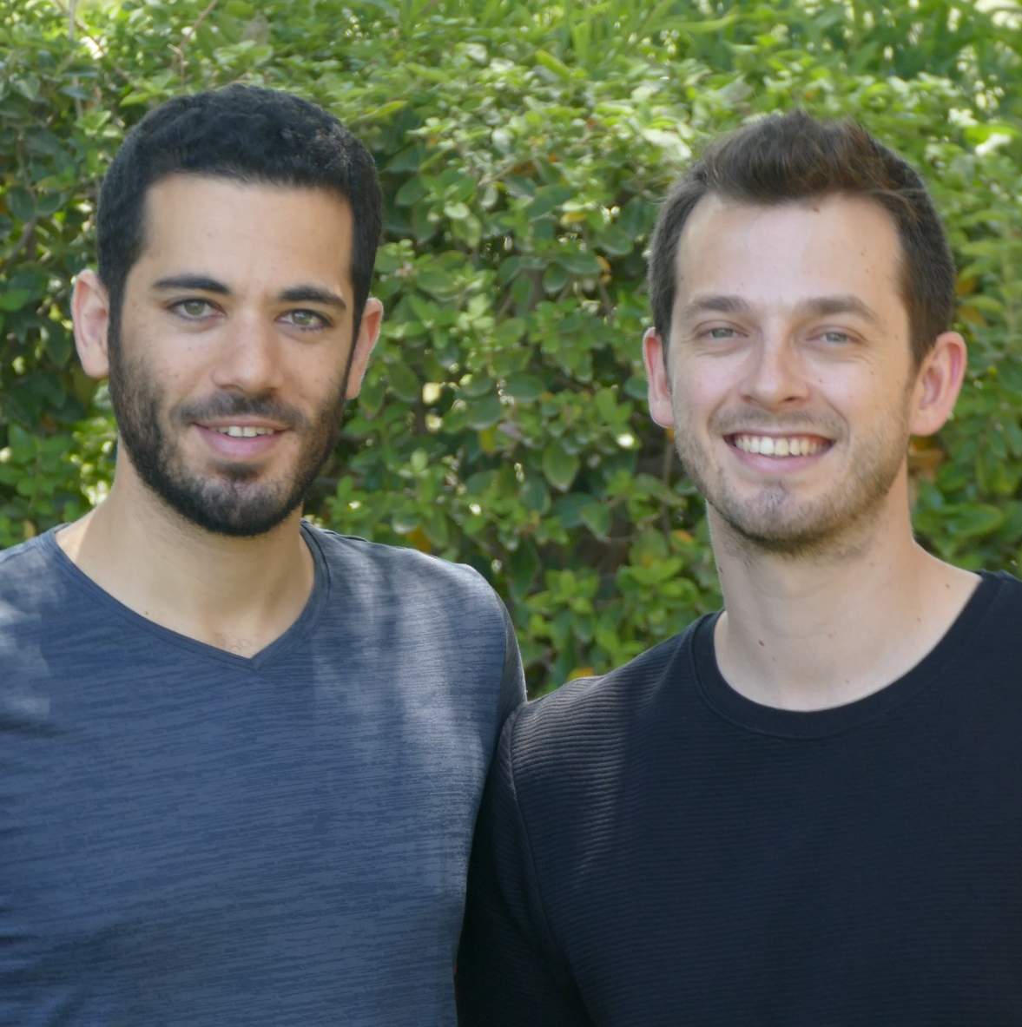
Team
Hillel Lehman
Shay Poleg
Co-Founder
CS- 2nd year
Co-Founder
MIS - 1st year

Slide 4

Problem
Lack of Information
Unreliable Information
Scattered Information

Slide 5

Mission
We’re providing genuine information about the accessibility of places
for people with disabilities and their close ones by a crowd sourced ratings and reviews mobile app.

Slide 6


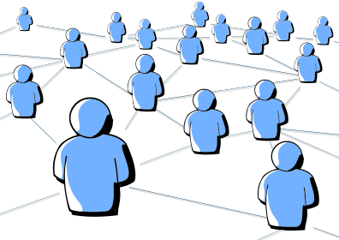
Solution
Quality of life
Promote Businesses
Connect People
Save time for our users and increase their daily independence
Leverage consumer buying power for businesses reaching out to a big market
Create meaningful relationships in communities

Slide 7

Market Size
People with disabilities in the world & in Israel
625K
1 Billion
1.4M
People with mobility impairments & physical disabilities living in Israel**
People with disabilities (Worldwide)*
People with disabilities living in Israel**
Source: *World Health Organization (WHO), 2018.
**The Central Bureau of Statistics and Myers-JDC-Brookdale Institute.

Slide 8
Market Size
14K
$5/month
Restaurants
in Israel
Pricing
Source: *Globes, Financial Paper.

Slide 9
Market Size
$840K +
$168K +
$16K +
Total Addressable Market
Serviceable
Addressable
Market
Share of Market
Source: *Globes, Financial Paper.

Slide 10
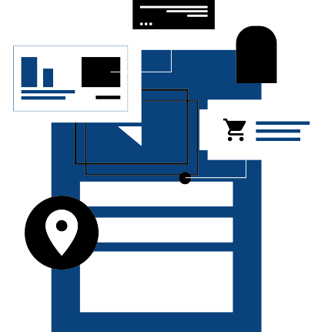

Business Model
In app ads
Businesses Promotion

Slide 11



Businesses Promotion
Targeted local advertising
Premium placement on
XSible search and competitor business pages
Presence on mobile
and desktop devices

Slide 12




Business Model Framework
BUSINESS
USER
Access
to market
Access
to market
Premium
XSible ads
Reviews & rankings

Slide 13
Competition
Access Israel web site
easy
Google Maps

Slide 14
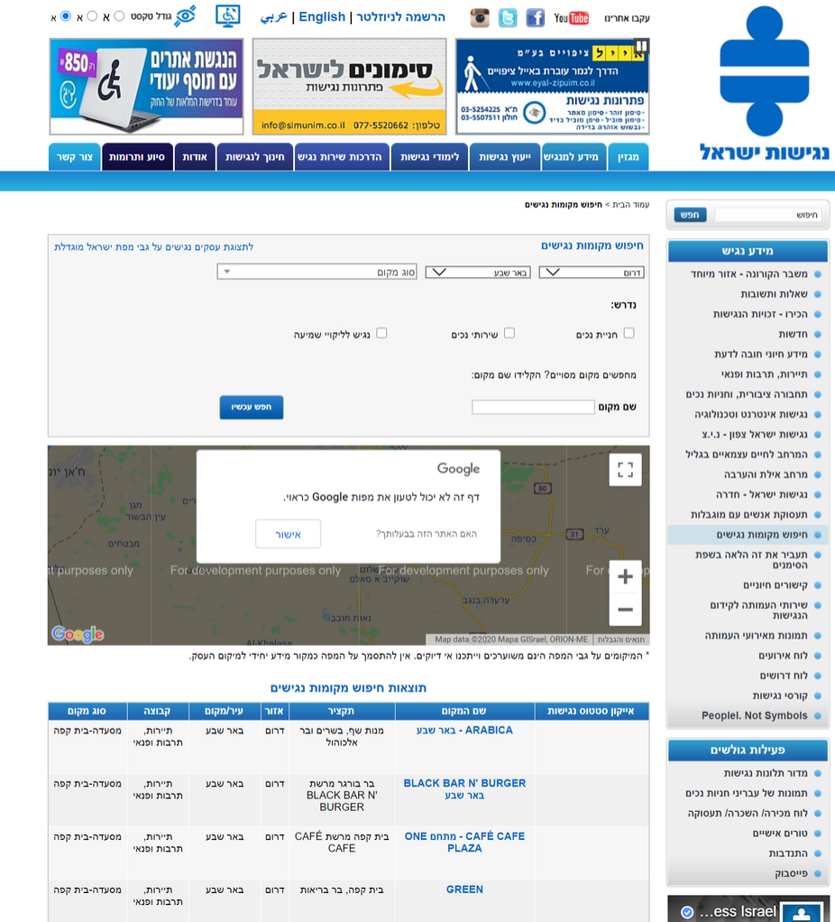
Access Israel

Slide 15
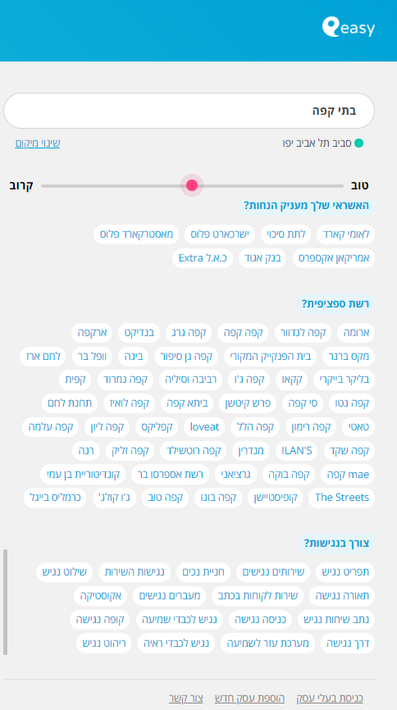
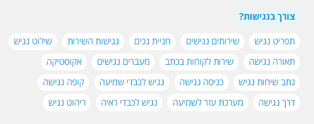
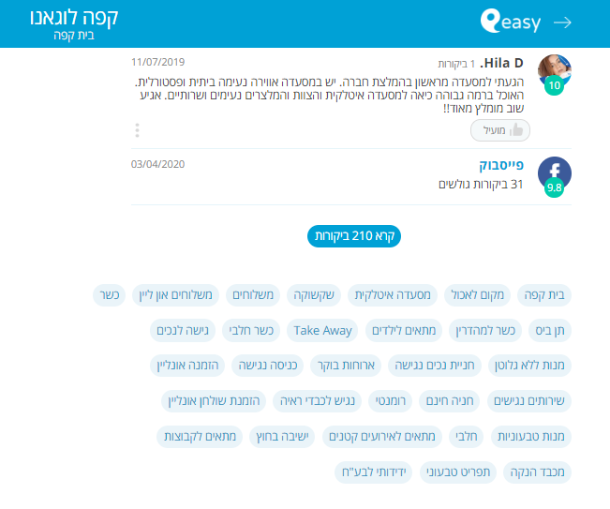
easy

Slide 16
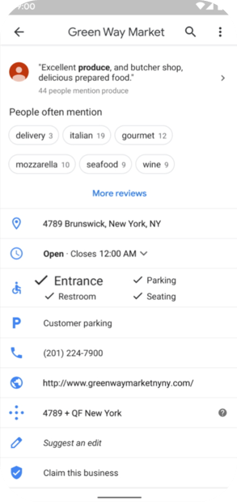
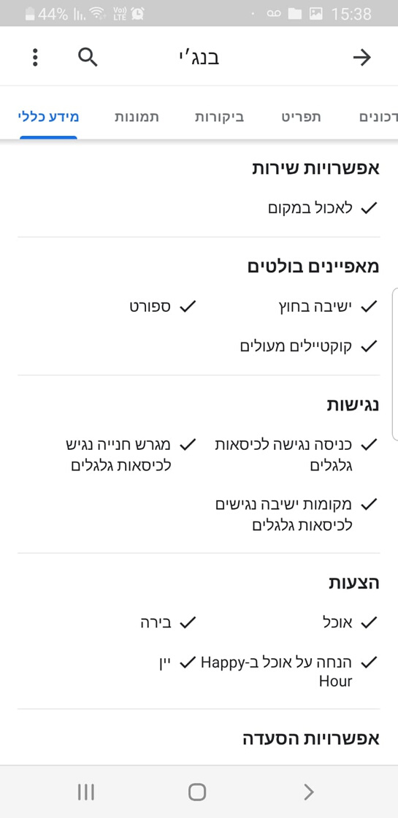
Google Maps

Slide 17

Accessibility Criteria
Parking
Entrance & Stay
WC
Service

Slide 18
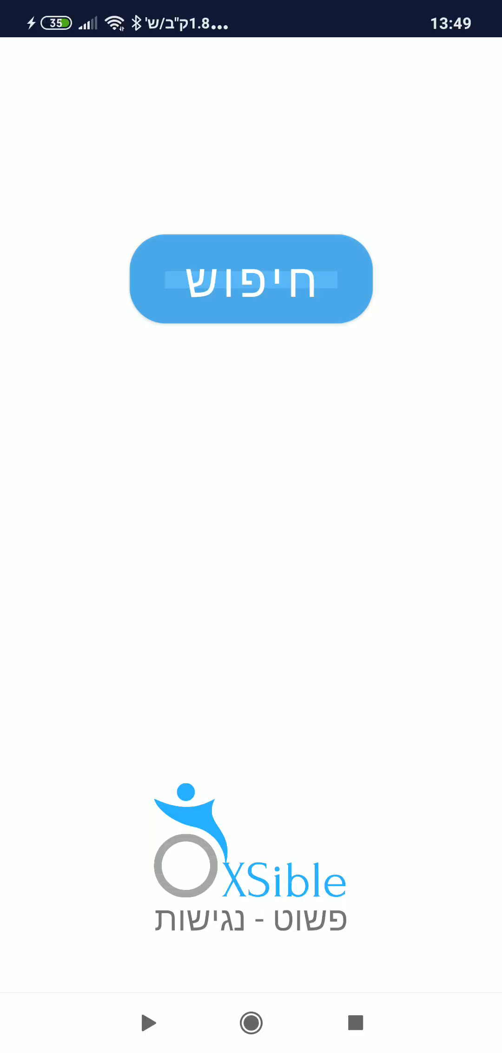
Demo

Slide 19
Competitive Advantage
Fast & easy access
Reliable Inforamtion
Network effect
Wider variety to choose from

Slide 20



6
RoadMap
5
4
3
December
2
November
Promotion Campaign
&
expansion
to 3 more cities
1
Aug - Sept
Finish implementation of customer feedback & pilot conclusions
August
Establish new strategic partnerships
June-July
Finish development of mobile & web beta platform
&
Launch pilot in
Be'er Sheva with clear KPI's
June-July
Partnership with Be'er Sheva Municipality & local groups
Participation in "Innovation in the Public Sector " program

Slide 21
We truly believe that we can make the world more widely accessible to ALL people.
Join us in making that come true!

Slide 22
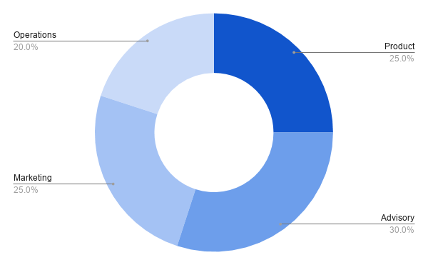
Use of Proceeds

Slide 23
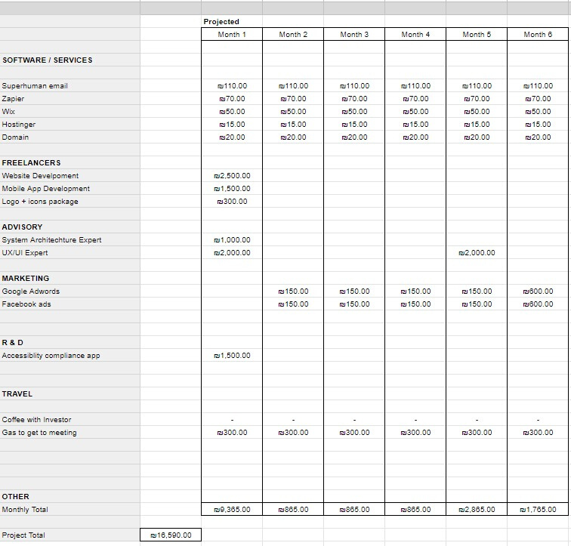
Budget

